Slide 1

Student Details
Name: Vishvas Sheshrao Landge
Skills Build Email ID: vishwaslandge2004@gmail.com
College Name: Matsyodari Shikshan Sanstha's Ankushrao Tope College, Jalna
College State: Maharashtra
Internship Domain: Artificial Intelligence And Machine Learning
Internship Start Date: 18/8/2023
Internship End Date: 30/9/2023

Slide 2
Problem Statement/Project Topic
Problem Statement: Analyzing Sentiment in Restaurant Reviews for Improved Customer Experiences

Slide 3
Agenda
Introduction: Introduction to Sentiment Analysis and Problem Statement
Project Overview: Purpose, Scope, and Objectives of the Project
End Users: Identifying the Target Audience and Their Needs
Solution and Value Proposition: Presenting the Project Solution and Its Benefits
Customization: Unique Aspects and Innovations in the Project
Modelling Techniques: Description of Applied Methods and Frameworks
Results: Presentation of Project Outcomes and Effectiveness
Links: Relevant Resources, GitHub Repositories, and Research Links
Conclusion: Summary of Key Findings and Achievements

Slide 4
Project Overview
Purpose: To analyze restaurant reviews and extract valuable insights for enhancing customer satisfaction and business operations.
Scope: Utilizing machine learning and natural language processing techniques to process large volumes of reviews.
Objectives: Improve customer experiences, optimize services, and boost overall restaurant performance.

Slide 5
Who are the End Users
Target Audience: Restaurant owners, managers, and staff.
Characteristics: Professionals seeking data-driven insights to enhance customer service, menu offerings, and overall customer satisfaction.
Benefits: Informed decision-making, improved customer interactions, and increased customer retention.

Slide 6
Solution and its Value Proposition
Solution: Developed a sentiment analysis model to categorize restaurant reviews into positive, negative, or neutral sentiments.
Value Proposition: Provides actionable insights from customer feedback, enabling restaurants to tailor their services, menus, and customer interactions.

Slide 7
How did I customize the project and make it My own?
Customization: I customized the project by selecting specific machine learning algorithms (XGBoost and Multinomial Naive Bayes) for sentiment analysis.
Innovation: Our innovation lies in the choice of models, data preprocessing, and performance evaluation tailored to sentiment analysis.
Uniqueness: I emphasize the unique aspects of our solution, such as the choice of classifiers and tailored text preprocessing, making it a powerful tool for sentiment analysis.

Slide 8
Modelling
Techniques: I utilized machine learning techniques, including XGBoost and Multinomial Naive Bayes, for sentiment analysis.
Methodologies: Our methodologies involved data preprocessing, vectorization, model training, and evaluation.
Technology Principles: I applied technology principles to develop efficient and accurate sentiment classification models.

Slide 9
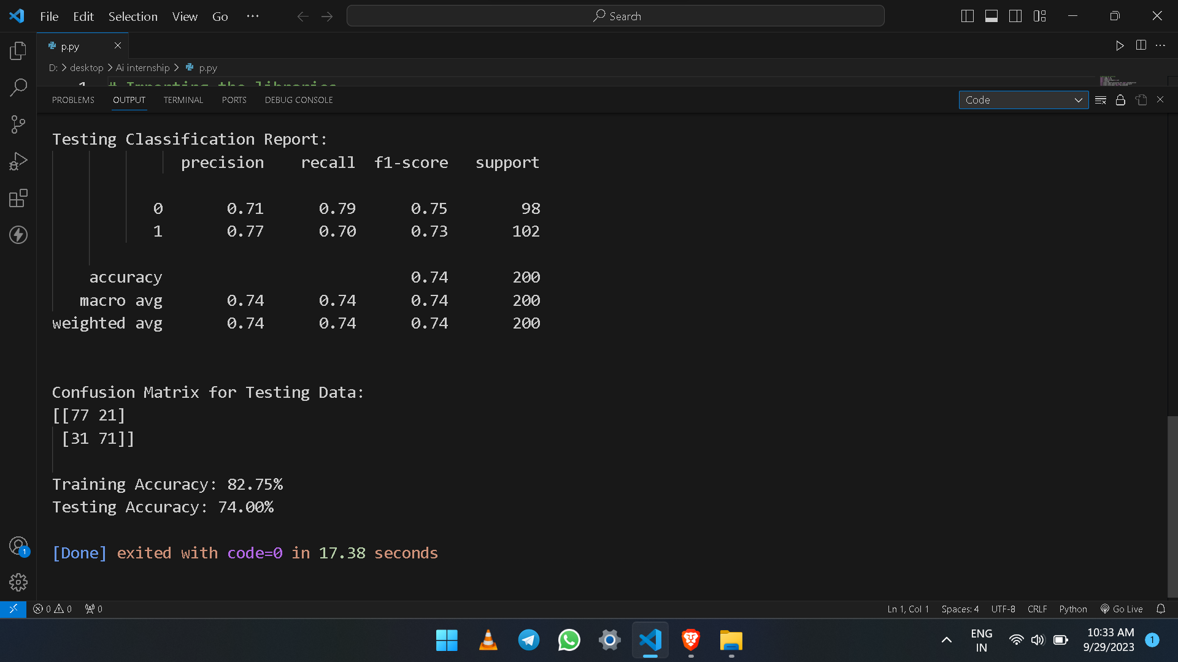
Results
Outcomes: Achieved an accuracy of 82.75% in classifying restaurant reviews, providing precise insights into customer sentiment.

Slide 10
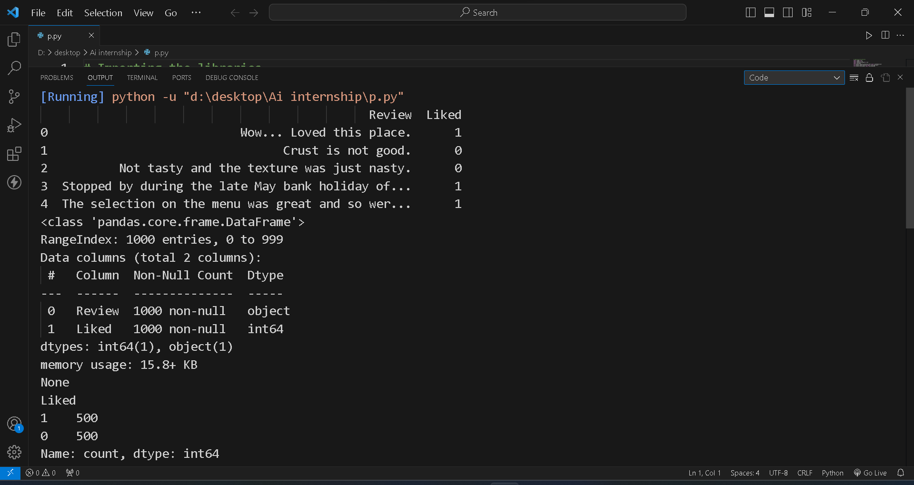

Slide 11
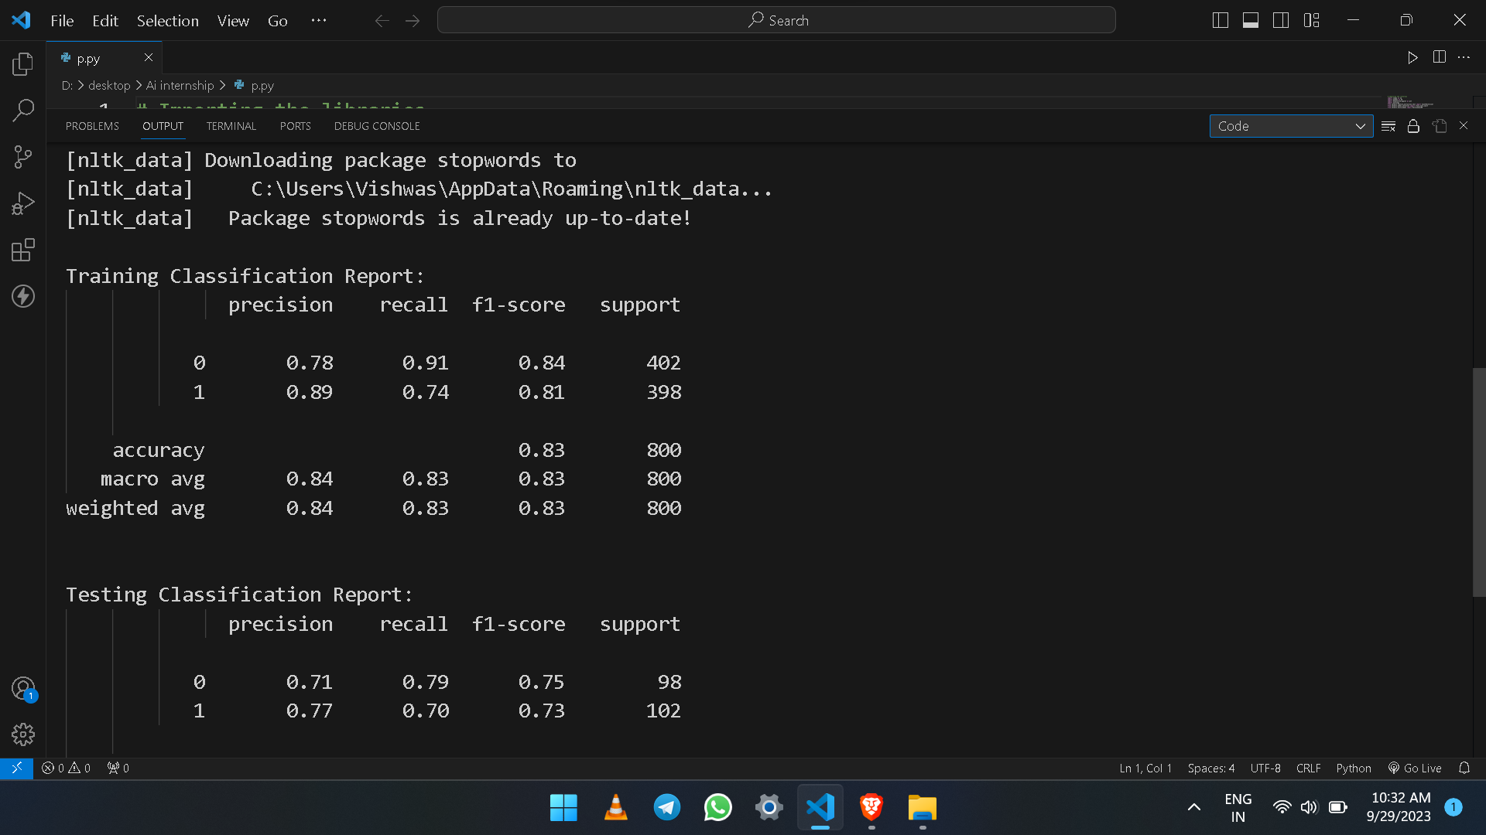

Slide 13
Links
Project Link : https://github.com/vishwas7264/Ai-Project
https://www.geeksforgeeks.org/xgboost/
https://www.sciencedirect.com/science/article/pii/S2090447914000550
https://www.v7labs.com/blog/data-preprocessing-guide
https://www.analyticsvidhya.com/blog/2021/07/performing-sentiment-analysis-with-naive-bayes-classifier/
https://vitalflux.com/sentiment-analysis-machine-learning-techniques/

Slide 14
Conclusion
Key Findings: Summarize significant insights obtained from the restaurant reviews.
Achievements: Highlight project accomplishments and how they contribute to the restaurant industry.
Future Work: Discuss potential future enhancements, such as sentiment analysis for specific cuisines or implementing sentiment-based menu optimizations.

